Slide 1
Ugly Face Jugs
Intermediate Art

Slide 2
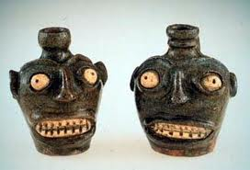

Slide 3
African Americans
First one is dated back in the 1840s.
Made by African slaves who worked as potters in South Carolina.
They would make functional Jars and jugs also.
Thought to have had a spiritual connection with the potter.

Slide 4
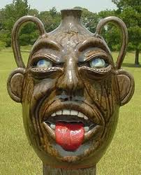

Slide 5
Ugly Face Jugs
Also called:
“Face Jugs”, “Devil Jugs,” “Voodoo Pots”
The Reason for the making of these jugs are still unknown.
The jugs were hand thrown on a wheel and the eyes and teeth were added with white clay for a contrast against the dark clay.
They were glazed.

Slide 6
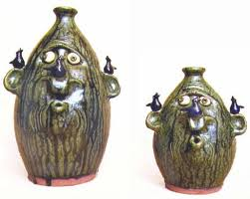

Slide 7
Ugly Face Jugs
In the 19th century white people began making these jugs b/c they were popular and they could make money off of them.
In the 1970s There was a huge interest in these Face Jugs.
These people were interested in American Folklore.

Slide 8
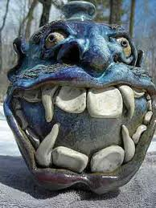

Slide 9
1970s popularity
Burlon Craig and Lanier Meaders were potters who helped bring back these face jugs, and made them more popular.

Slide 10
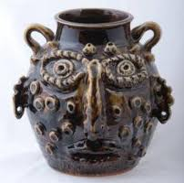

Slide 11
American Folklore
These Jugs may have been used to distinguish the liquid inside.
Maybe the one’s with the faces were the ones you shouldn’t drink from.
According to family folklore, they were used as a slaves’ grave marker to scare the devil away.
Maybe they contained moonshine, and they were ugly to scare away the children.

Slide 12
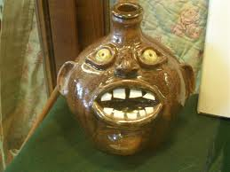

Slide 13
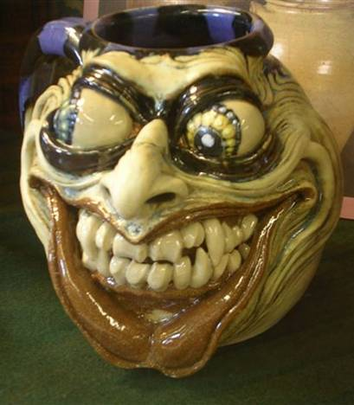

Slide 14
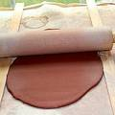
When Making Our Jugs:
Start with a slab.
Roll it out on a clean surface.
Preferably a wooden surface.

Slide 15
The Base
Cut the base to the size you want.
Make sure it’s smooth and even to start coiling.

Slide 16
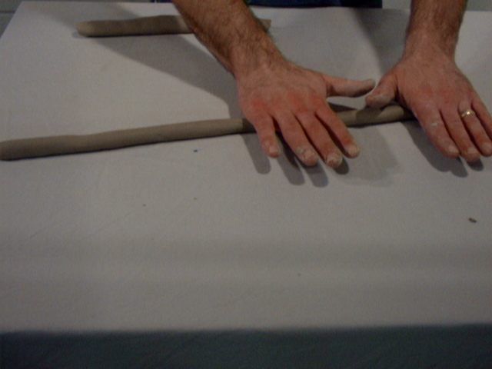
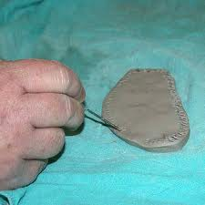
Coiling
Roll out pieces of clay a little thicker than a pencil.
Score the base piece where the coil will lay. Also Score the coil.

Slide 17
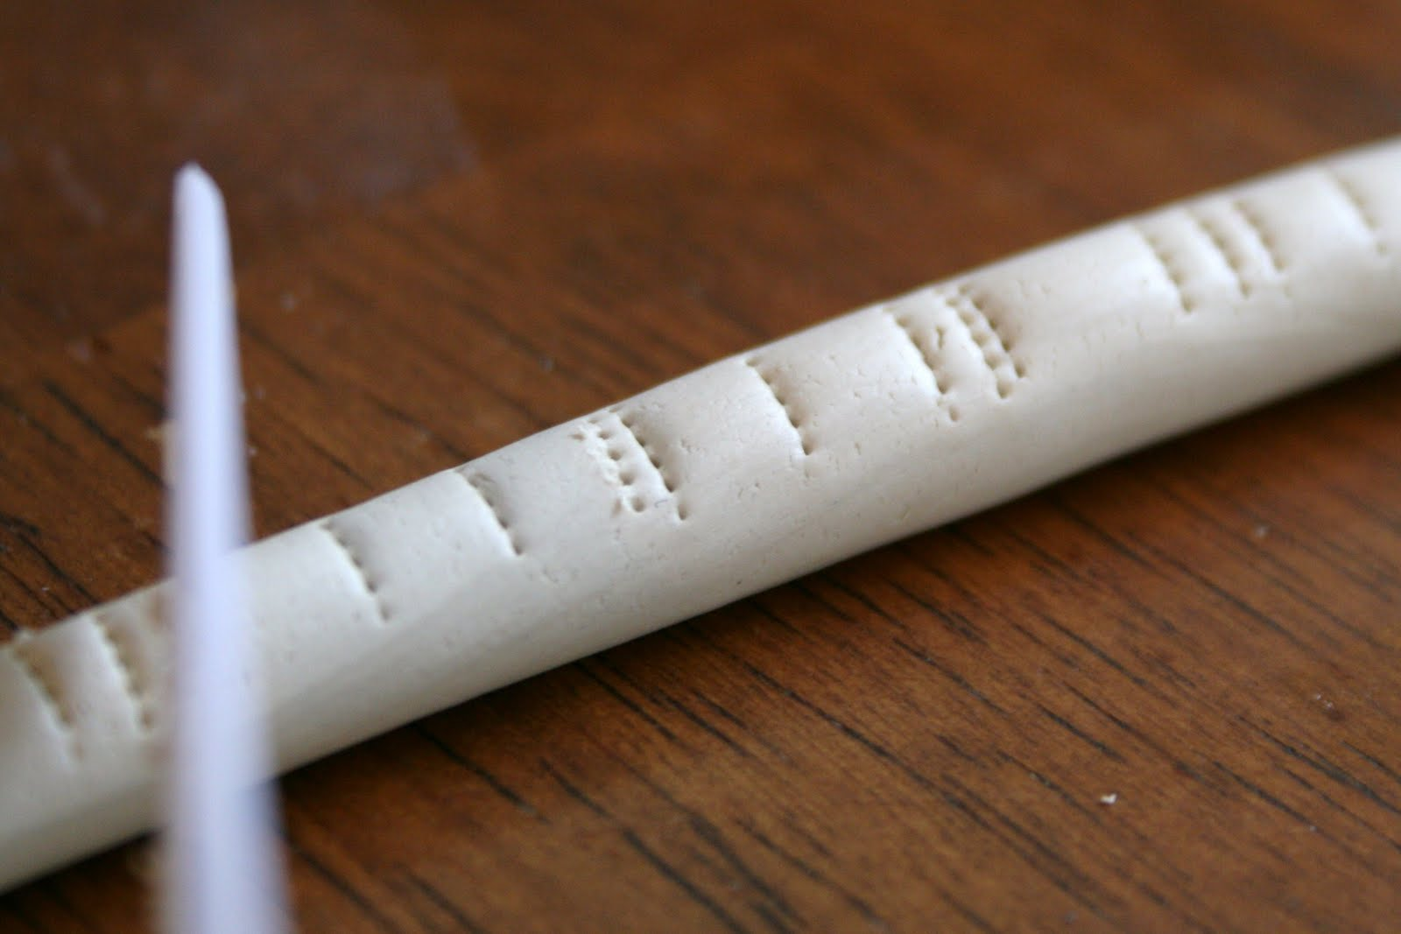
Slipping
After scoring the base and the coil, add Slip.
Slip is just wet clay gently rubbed over the surface of the coil. It acts as a “glue”

Slide 18
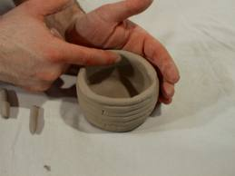
Smoothing the coils
Smooth the coils on the Inside of the jug in a downward motion.
Smooth the coils on the Outside of the jug in an upward motion.
This helps your jug be even

Slide 19
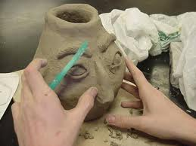

Slide 20
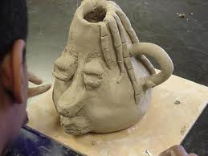

Slide 21
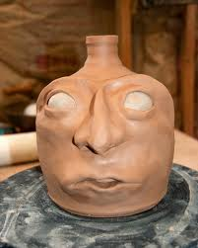
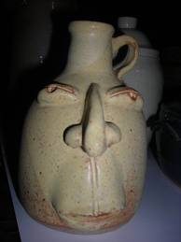

Slide 22
Keeping Clay
While working on your jug do the following:
Do not touch other people’s projects.
CLEAN, CLEAN, CLEAN!!! Clean off your tools, Clean the tables!!! And, cover your clay in a damp paper towel to keep the clay soft over night.

Slide 23
Keeping Clay
3. If it’s a weekend, the paper towel must be really damp (not soaking wet) and placed in a plastic bag!
Leave your jug on your wooden board and place on shelf.
Make yourself a NAME TAG so others don’t touch your jug!!
Have fun!!

