Slide 1
STEVE JOBS
Feb. 24, 1955
To Oct. 5, 2011

Slide 2
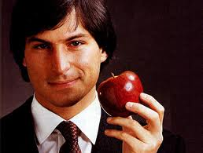

Slide 3
Steve Jobs
Co-founder and chief executive of Apple Inc.
Also Chief Executive of Pixar Animation.
When Disney acquired Pixar in 2006, Jobs also joined the board of directors for Disney.
Steve Wozniak is the co-founder of Apple Inc.

Slide 4
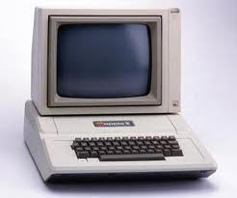
First Popular Apple Computer. Apple II Series

Slide 5
Beginnings of Apple Inc
Wozniak began building a computer board completely different than any computer.
Jobs and Wozniak were friends and Jobs quickly got on board.
They started the Apple company together April 6th, 1976

Slide 6
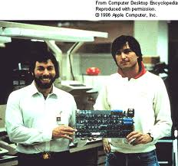
Wozniak and Jobs With the first Apple Computer Board.

Slide 7
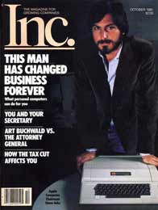

Slide 8
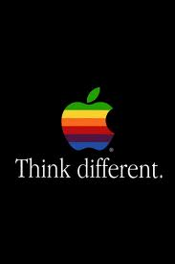
Macintosh Computers
Jobs branched out from his old partner and created the Macintosh computer that did not become a huge success until the 90s

Slide 9
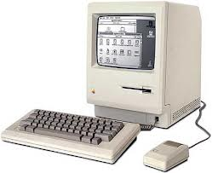
1981 Macintosh

Slide 10
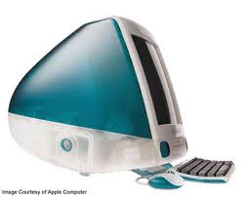
1990s Mac

Slide 11
1986 Pixar
Steve brought together a small group of computer scientists to make a computer that is compatible with everything ANIMATION.
First digital short “Tin Toy” in 1989
Toy Story was the first full length Pixar/Disney animated film used with Apple computers.

Slide 12
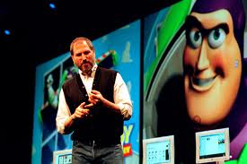

Slide 13
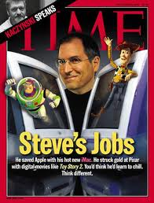

Slide 14
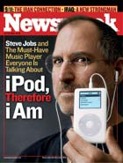
2002 first iPod

Slide 15
The iPod
Steve Jobs with his iPods changed the music industry forever.
iPods didn’t only boost mac sales, but PCs, mp3 players, and online sales. (iTunes)
Still Changing for the better, along with the computers.

Slide 16
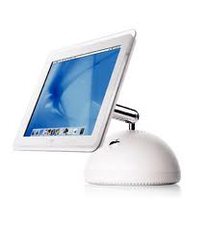
2002 Apple Computer

Slide 17
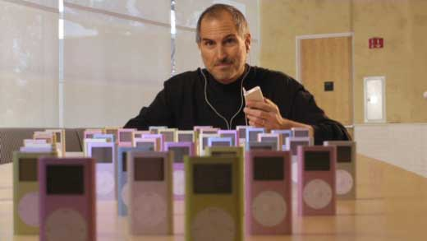
Jobs with 2004 iPod

Slide 18
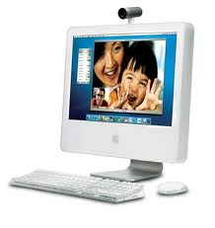
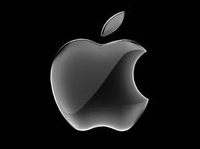
2004 Apple Computer

Slide 19
Touch iPhone
In 2004 Jobs wanted to create a touch tablet of some kind, and realized the highest marketed product was the cell phone.
In 2005 work began on the iPhone touch.
The first successful iPhone was introduced in 2008.

Slide 20
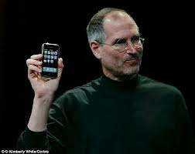
The first iPhone

Slide 21
Decreasing Health
Jobs was diagnosed with cancer in 2003 but was able to contain it until 2009 when it came back.
He was able to introduce the iPhone 4, iCloud, and the iPad 2 before he passed in October of 2011.
The iPhone 4s was introduced the day before he passed.

Slide 22
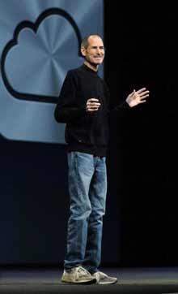

Slide 23
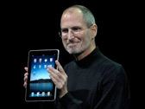

Slide 24
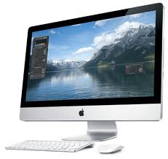
Today’s iMac

Slide 26
