Slide 1
Printmaking
Expeditionary Project

Slide 2
Different types of Printmaking
WOODCUT
Relief Print b/c the image is raised, it “sticks up” from it’s base.
The artists draws on a piece of wood, then cuts away the parts that will remain white.
Ink is rolled on to the wood’s surface.
Paper is pressed on the block and the image appears.

Slide 3
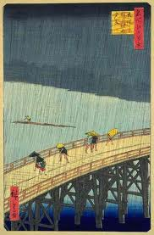
Ando Hiroshige
Colorful
Many different blocks were used to add all the colors
“Rain Showers on Ohashi Bridge” 1857 13”
Cleveland Museum od Art

Slide 4
Intaglio
Woodcuts are printed from the raised surface, where Intaglio prints are made from the ink from the crevices in the plate.
The artist scratches the metal plate with a tool, this can be done with Acid Etching, or Dry Etching.
Forced ink into the grooves, and the rest of the plate is wiped clean.

Slide 5
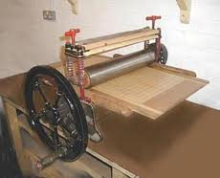
Intaglio cont..
The paper that is being printed on must be damp.
The paper is placed on the metal sheet and rolled through a huge printing press

Slide 6
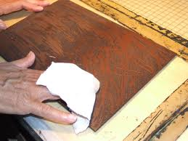
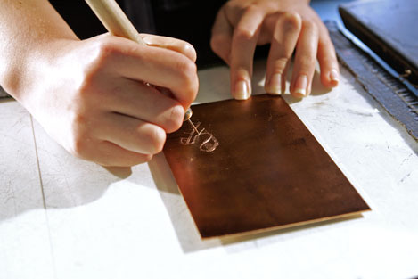
Intaglio cont…

Slide 7
Linocut
Also a relief cut. Similar to woodblock.
Uses cutting tools and linoleum.
Ink is rolled over the surface with a brayer.
Can be very detailed, or rough, it can also show evidence of the tool by the texture.

Slide 8
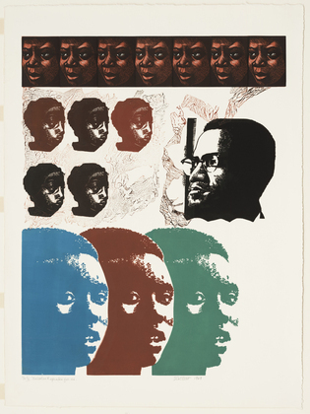
Linocut (Linoleum Block)
Elizabeth Catlett
Malcolm X Speaks to Us
1969

Slide 9
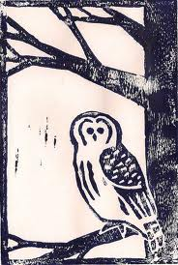
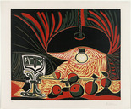

Slide 10
Lithograph
Appear black & white, full of color, and may seem flat.
The artist draws a design on a limestone slab with a greasy crayon or ink.
Then water is spread over the stone.
Then a Greasy ink is spread over the whole surface, the ink will not spread where there is water. (oil & water don’t mix)

Slide 11
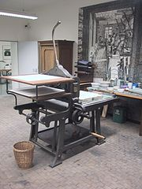
Lithograph cont…
A sheet of paper is placed on the slab and run through a press.
This takes practice to perfect.
Each color needs to have it’s own stone & have perfect placement.

Slide 12
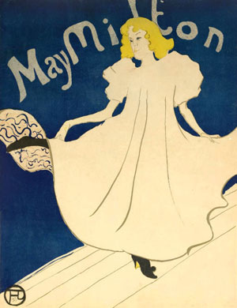
Henri De Toulouse Latrec
May Milton, 1895
Lithograph
The Print is going for $45,000

Slide 13
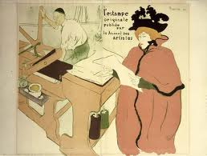

Slide 14
Henri De Toulouse Latrec
French
Born in 1901
As popular and as appreciated as Cezanne and Van Gogh.
Had a disease that stunted his growth, only 5”1
Liked to party at Moulin Rouges.
Died at 36 from alcohol related problems

Slide 15
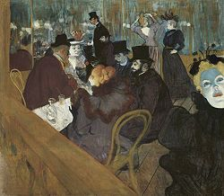

Slide 16
Serigraph
Newest form of printmaking
Serigraphy or Silkscreening
Stretched a piece of silk over a frame, a stencil is attacked to the frame, then ink is pressed through the fabric with a rubber squeegee onto a piece of paper, or other fabrics.
A new stencil is needed for each color.

Slide 17
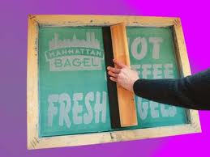
Serigraph (silkscreen)

Slide 18
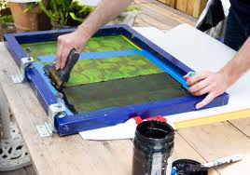

Slide 19
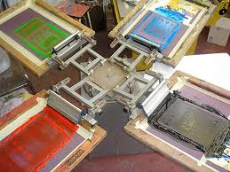

Slide 20
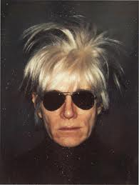
Andy Warhol
1928-1987
Started the art movement called POP ART
Hometown Pittsburgh, PA where the Warhol Museum is located.

Slide 21
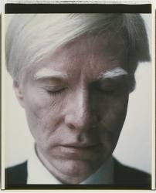
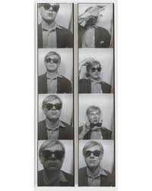
Andy Warhol

Slide 22
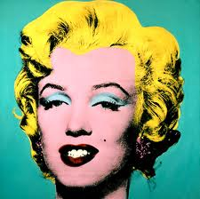
Celebrity Influences
Warhol had celebrity influences in his printmaking and paintings.
People imitate his style still.
Marilyn Monroe

Slide 23
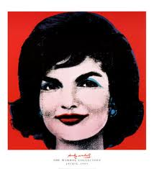
Jackie Kennedy

Slide 24
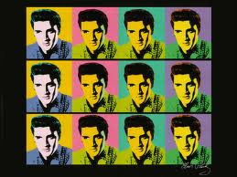
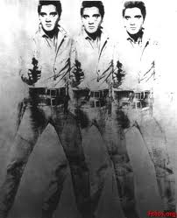
Elvis Presley

Slide 25
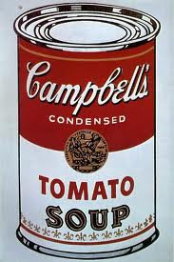
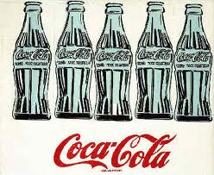
Everyday Objects

Slide 26
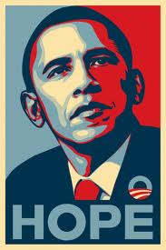
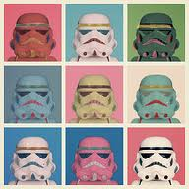
Warhol Imitation

