Slide 1
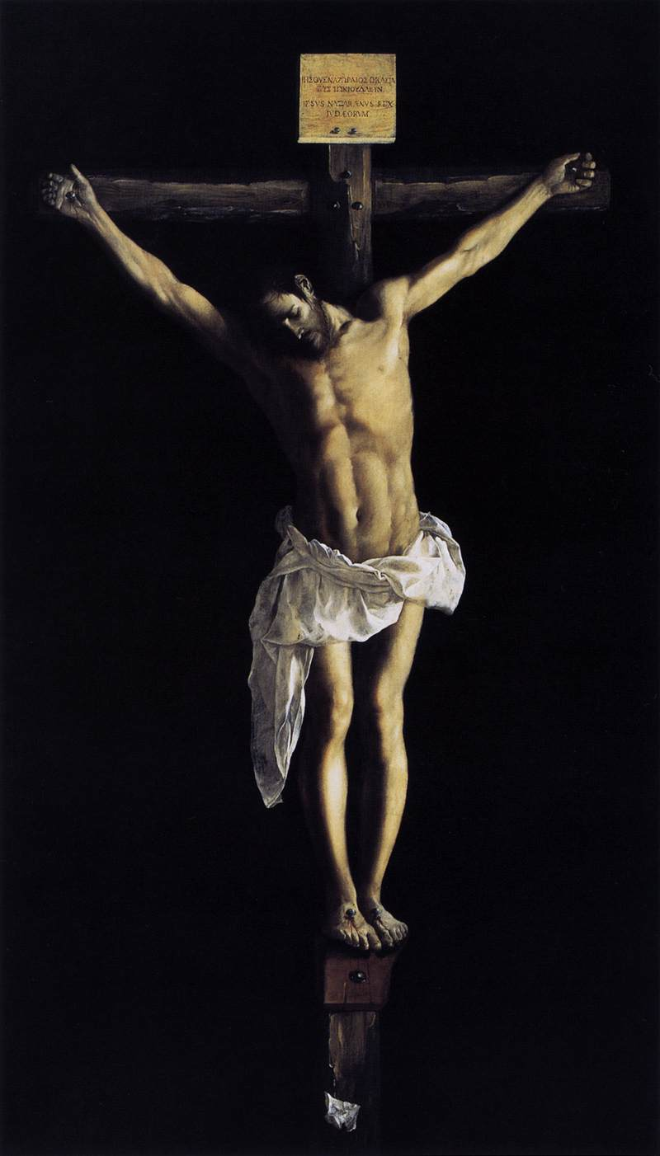
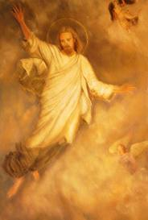
Religious Convictions

Slide 2
Ch.7 Religious Conviction
During the Greek and Roman period, before the birth of Christ, art had been realistic.
The Early Christians would make their artwork more symbolic.
They were not allowed to practice Early Christianity in the Roman Empire.

Slide 3
Early Christians
Around 313AD Christianity became the official religion of Rome, and they began to build churches.
The rival to the Early Christians was Islam(Muslims)

Slide 4
Early Christian Art The Archangel Michael
During the Early Christian era, large sculptures weren’t made.
Some carvings were done for book covers, stone coffins, and church furniture.
The Archangel Michael was an ivory panel, and was stylized instead of representing someone.

Slide 5
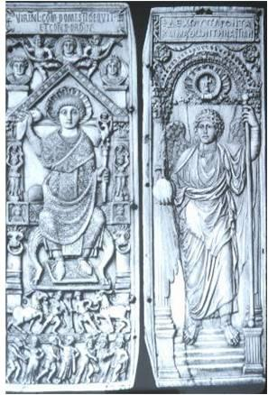
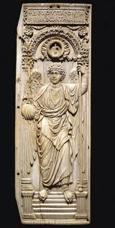
The Archangel Michael

Slide 6
The Archangel Michael
Diptych: a pair of panels usually hinged together, usually placed over an altar.
This angel hold a power from God.
He represents a messenger from God and a mighty warrior.

Slide 7
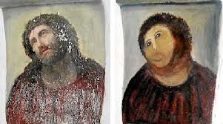
Thinking like a Conservator
Pg. 207
Summarize

Slide 8
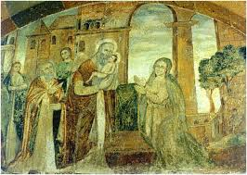
Early Christian Frescoes

Slide 9
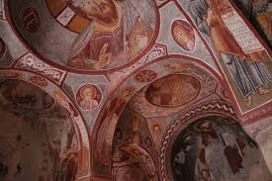

Slide 10
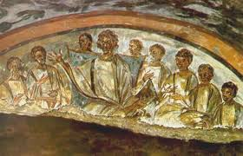

Slide 11
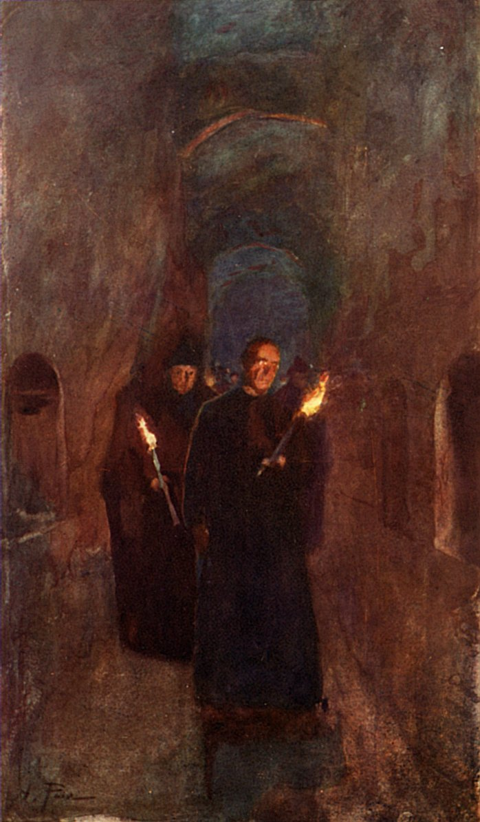
Early Christian Frescos
Before the Era of Constantine, Christianity was outlawed in Rome.
Christians were often persecuted for practicing Christianity so they hid in catacombs.

Slide 12
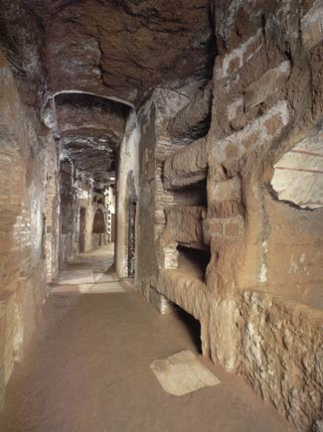
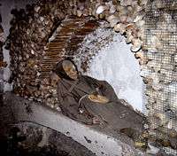
Catacombs

Slide 13
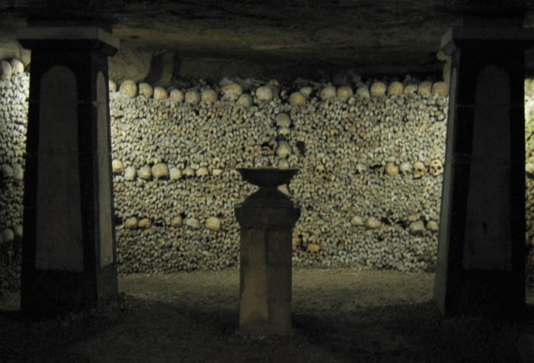
Catacomb

Slide 14
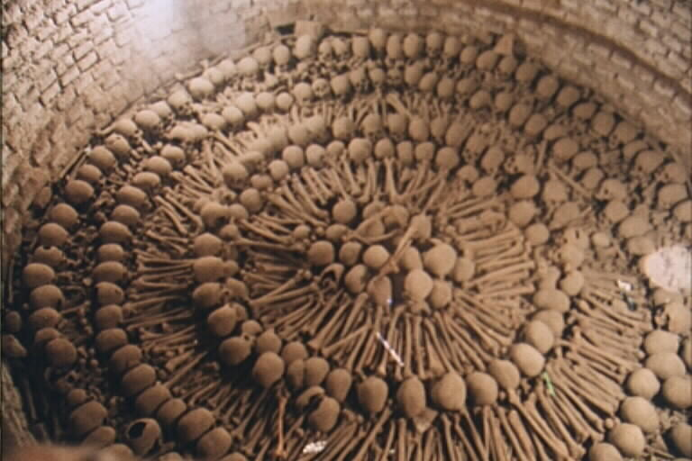

Slide 15
Catacombs
Underground burial places made up of passageways sometimes contained chapels.
Roman law didn’t allow burial in the city, so families would bury them in the catacombs.
As many as 4 million people are buried in them.

Slide 16
Catacombs
Frescos covered the walls of the catacombs.
“The Good Shepherd” Jonah & the Whale
After Christianity became the official religion, catacombs were abandoned.
Resembles ancient Egyptian tombs.
Read pg. 208

Slide 17
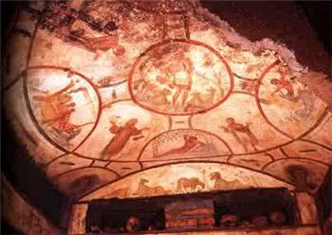
Jonah & the Whale

Slide 18
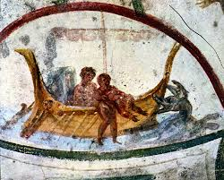

Slide 19
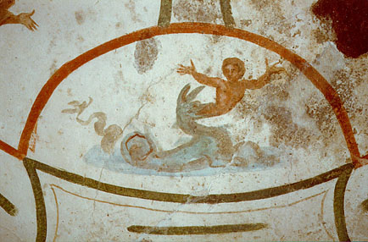

Slide 20
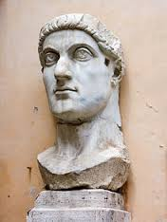
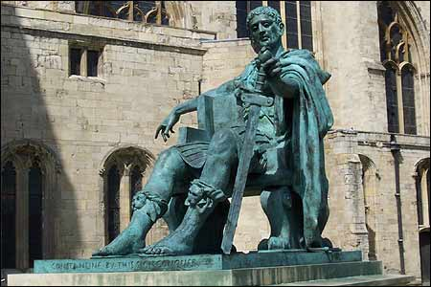
Constantine the Great

Slide 21
Constantine
When the Christians were lifted from being persecuted all those years, they got their money and property back.
Constantine hoped to restore public order and peace.
He ordered that the huge church now called “Old St Peter” be built.
He built many other Christian churches.

Slide 22
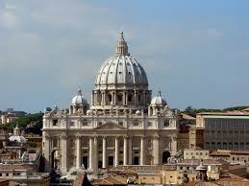
Old St Peter’s Basilica

Slide 23
Old St Peter’s Basilica
Old St. Peter’s church in Rome.
Had been burnt down and rebuilt, even the highly decorated interior was repainted.

Slide 24
The Beginnings of Christian Churches
Constantine ordered the “Edict of Milan” this meant that Christianity was the main religion.
Now that Christianity is allowed, they needed architecture to hold all the worshipers, so they built Basilicas.

Slide 25
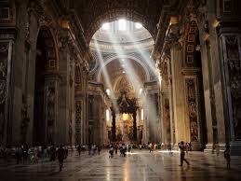

Slide 26
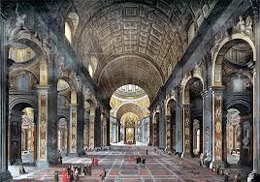

Slide 27
Beginnings of churches
The Nave is the central part of the basilica where the worshipers would be.
On the other side of the columns are the aisles.
Around 40 of the original 300 basilicas are still standing today.

Slide 28
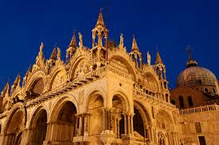

Slide 29
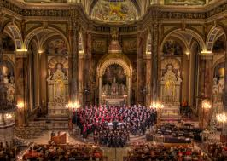

Slide 30
Sculpture and Metalworking
Since the Christians were not allowed to practice Christianity for awhile, sculptures were either destroyed or not made b/c it was hard to hide them.
“The Good Shepherd” is a sculpture of Christ as a youth.
The “Chalice of Antioch” made of Silver, story pressed into the sides.

Slide 31
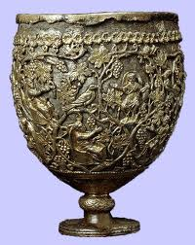
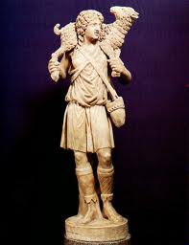
The Good Shepard and Chalice

Slide 32
Sarcophagi
Coffin – like boxes made of stone.
Pg.211
Used as a casket.
Originally made by the Romans, and the Christians put their subject matter on it.

Slide 33
Byzantine Art Ch. 7.2
Pg. 212
After the Death of Constantine in 337AD, the Roman Empire was split into the East and Western empires.
The West fell, the East had its’ capital in Constantinople and gained political strength.

Slide 34
Justinian
Justinian took the throne of the Eastern Roman Empire(Byzantine) in 527AD
“The Golden Age” of Byzantine culture and art.
Beautiful Churches that were just brick on the outside but elaborately decorated on the inside.
He also had the job of simplifying Roman law.

Slide 35
Justinian and Theodora Mosaics
Roman mosaics were made of polished stone.
Byzantine Mosaics were made of brightly colored glass pressed into plaster.
The church of San Vitale in Ravenna has the most striking mosaics.
Mosaics cover almost every surface and tell biblical stories.

Slide 36
Emperor Justinian and Attendants
Taking part in “Communion” Justinian is carrying the bread basket.
Justinian has a halo around his head that represents God’s holy representative.
The people are positioned according to their rank.
The people closer to Justinian, the more important.

Slide 37
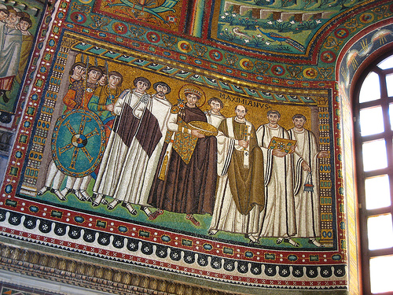
Emperor Justinian and Attendants

Slide 38
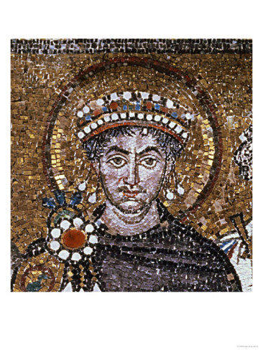

Slide 39
Emperor Justinian and his Attendants
Emperor is wearing Imperial Purple.
The Bishop Maximus has his name written above his head to show his importance.
His army is behind the shield.

Slide 40
Empress Theodora and Attendants
Also taking part in “Communion” she carries the golden cup containing wine.
Bodies are all tall and seem very flat, there is no sense of space.
Large eyes
Look like they’re posing.
Also used Gold.

Slide 41
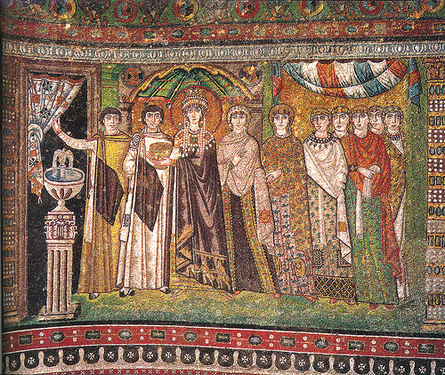
Empress Theodora and Attendants

Slide 42
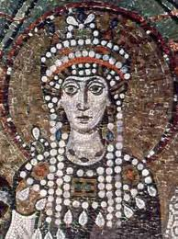

Slide 43
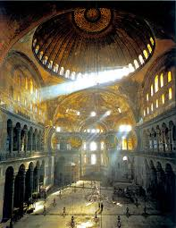
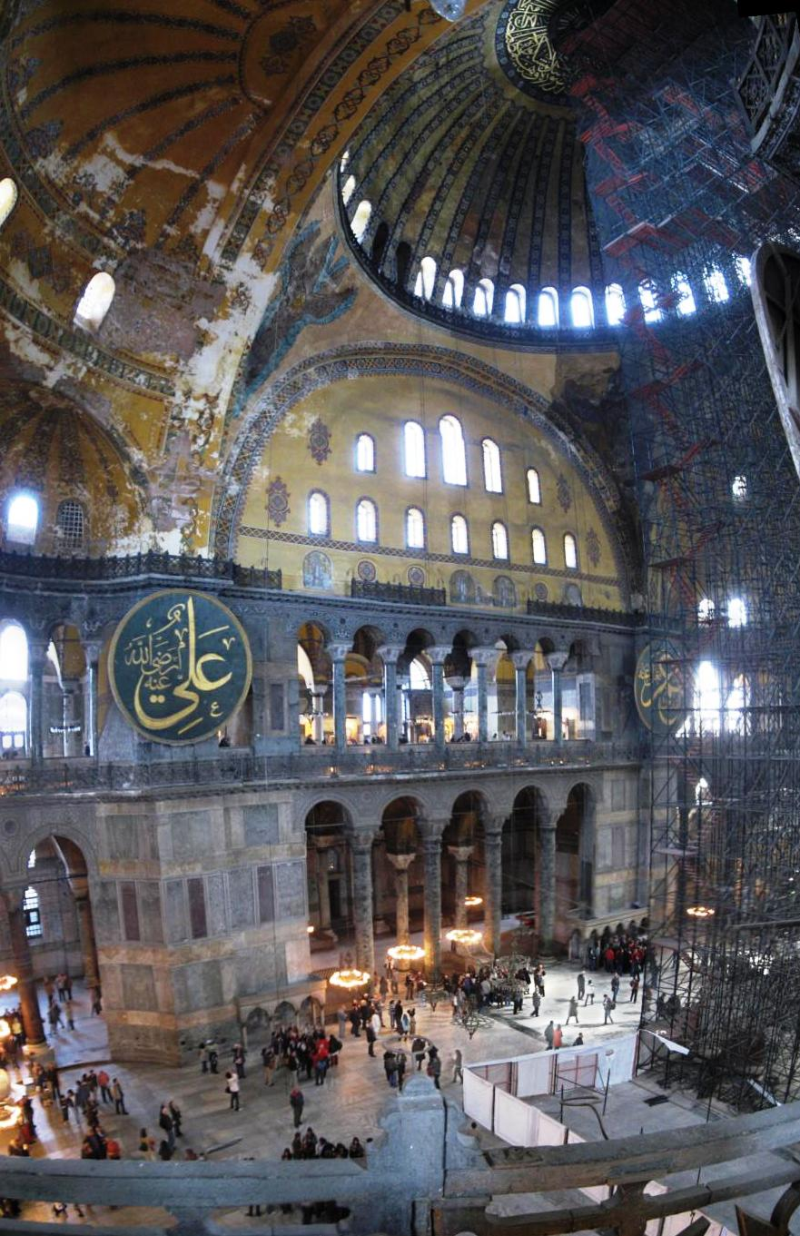
Hagia Sophia –(Justinian)

Slide 44
Hagia Sophia
Was built right where other temples had burnt down. Around the year 532 AD
Took thousands of workmen to build it in 6yrs.
Made with brick, marble, and colorful stone.
Been destroyed countless times by war, and earthquakes.
At one time has the largest interior space of any building.

Slide 45
Hagia Sophia
Originally covered with bright mosaics.
Eyewitnesses said walking into the building felt like walking into heaven.
The Muslims later converted the church into a mosque and scraped all the mosaics off b/c their religion did not allow depiction of people.

Slide 46
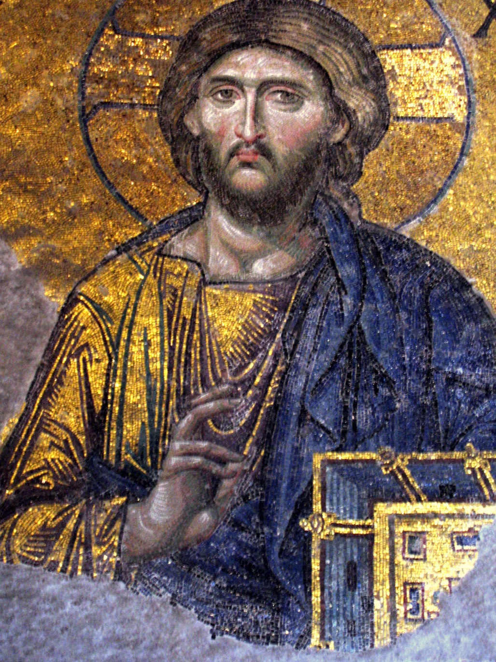
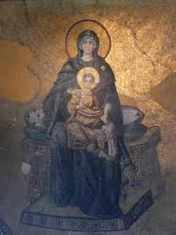
Mosaics in Hagia Sophia

Slide 47
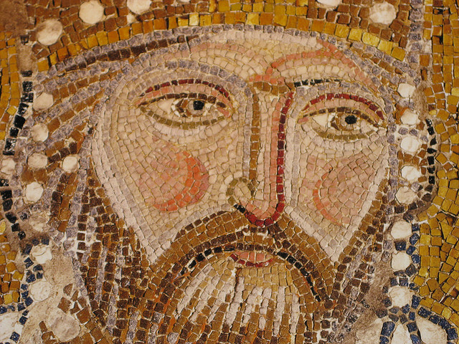

Slide 48
Hagia Sophia
Plaster covered the walls and paintings were placed over top.
Today, people have been trying to restore old mosaics from under the plaster.
Today it is a museum.

Slide 49
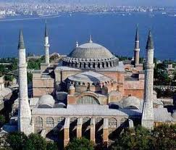

Slide 50
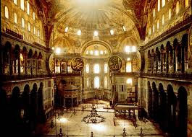

Slide 51
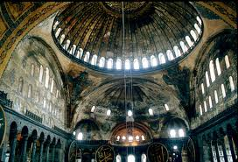

Slide 52
St. Mark’s in Venice
After a few hundred years with no architecture reaching the height of Hagia Sophia, St. Mark’s church was built in 1063AD.
Now has mosaics on the outside of the church, and over 2000 columns. The interior is also highly decorated.

Slide 53
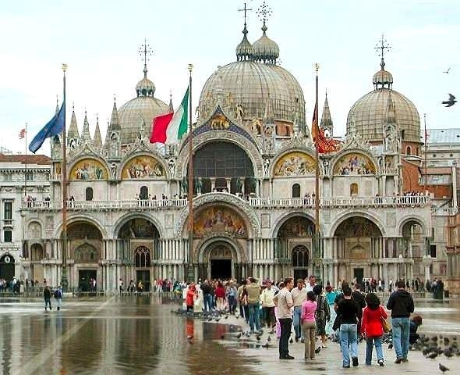

Slide 54
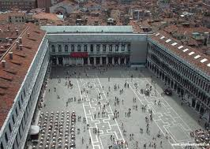

Slide 55
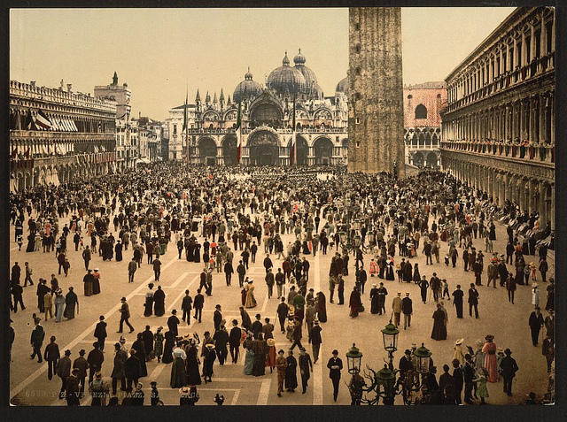

Slide 56
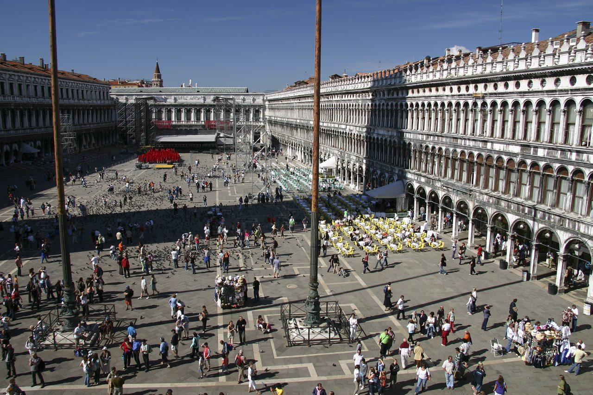

Slide 57
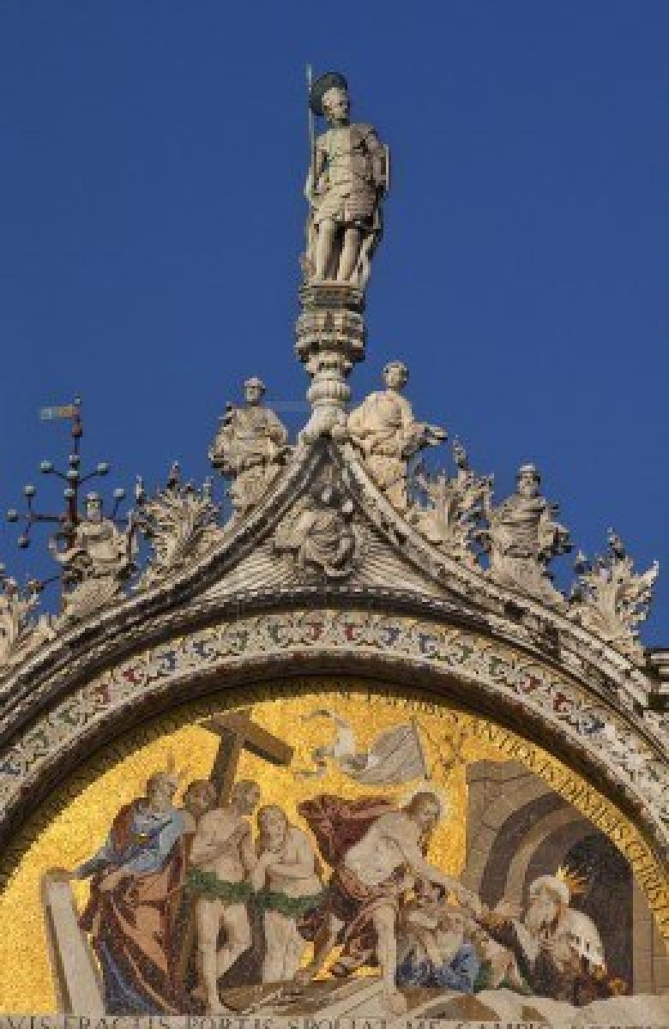
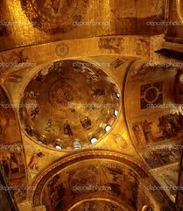

Slide 58
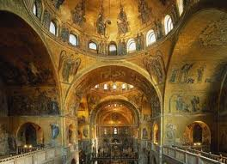

Slide 59
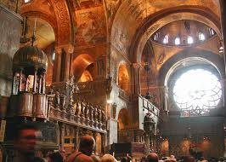

Slide 60
Byzantine Painting and Sculpture
We know they excelled in mosaics.
Most paintings were Icons (religious figures)
Painted with egg tempera, and usually had a golden background.

Slide 61
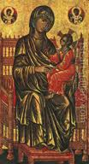
Enthroned Madonna and Child
Figures hover, rather than just sit.
Fabric is abstract (not realistic)
Resembles traditional Byzantine art.

Slide 62
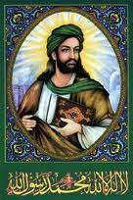
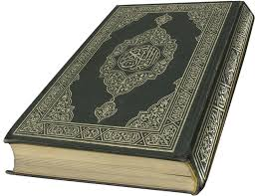
Islamic Faith and Art
Ch. 7.3

Slide 63
Islamic Faith and Art
Islam refers to the Muslim faith, and the nations that follow with the same religion.
Mohammed is their founder, said to be a messenger from God to save the people.
Christianity’s rival

Slide 64
Islam Faith
Their Muslim religion influenced Medieval Europe.
Did not allow human figures in their religious artwork.
Geometric and Abstract designs developed to look pretty.

Slide 65
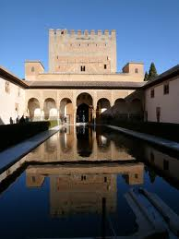
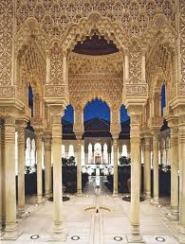
Alhambra Palace

Slide 66
The Alhambra Palace
Built in Spain.
The Alhambra Palace is an example of Islamic arch construction.
Royal housing, offices, baths, and a mosque.
Most famous for its Courtyards full of fountains.

Slide 68
Court of the Lions
Most famous courtyard of the Alhambra.
Lots of columns
Arches are decorated with stucco relief.
The detail in the stucco relief gives the Court of the Lions an airy feeling.
Has symmetry and rhythm.
Can be compared to Hagia Sophia in beauty

Slide 72
The Koran
Sacred book of Islam
Contains the spiritual and social law.
People were forbidden from their art.
So, Calligraphy became the art.
The Koran is written in Calligraphy.

Slide 75
Vocab
Arabesque
Stucco
Mosque
Minarets
Miniature

Slide 76
Mosques
An Islamic place of worship, (church)
Pg.220
Many Muslims converted Christian churches into mosques (Hagia Sophia)
All mosques are meant to look like Mohammed’s house.
Most all mosques have a courtyard

Slide 77
Dome of the Rock

Slide 78
Dome of the Rock

Slide 79
Dome of the Rock

Slide 80
The Dome of the Rock
Muslims from many countries came together to build this mosque.
Jerusalem
Placed on a high rock mountain where it was said that Mohammed left the earth.
Also thought to have been the place where Abraham attempted to sacrifice his son Isaac.

Slide 81
The Dome of the Rock
Large Dome that used to be covered in Gold, and is now glistening Aluminum.
Was covered in Byzantine glass mosaics, but now is covered in brightly glazed ceramic tiles.
Around 643 AD

Slide 83
Islamic Book Illustration
Used detailed designs and featured elaborate geometric patterns.
This style was highly developed b/c they weren’t allowed the use of people.
“Laila and Majnun” fig.7-27example of a “miniature”(small picture) from a manuscript.
People can be shown b/c it’s a poem instead of a religious work of art.

Slide 84
Ch. 7.4 Early Medieval Art
The medieval ages span over 100 years.
After the Fall of Rome, people had to migrate, and between the years 400-600, not many paintings or buildings were constructed.
People had to carry their art with them, so it was often small, used as a weapon, or objects of daily use.

Slide 85
Early Medieval Art
Most of these traveling Tribes that went into Europe were Christian, but some were pagan, and had a lot of dragons in their artwork.
Animals were a common theme.
Manuscript (writing) became an important form of art.
Illumination: Colored illustrations, decorated manuscripts during medieval times. Sold by Monks.

Slide 86
illumination

Slide 87
The Lindisfarne Gospel Book
Influenced by Christian Art.
Also liked flowers, animals, and design work
Monks spent a lifetime alone working on these manuscripts.
Monks were artists.
They believed that illuminating these scripts, they were honoring the word of God.

Slide 88
Lindisfarne Gospel book

Slide 89
Lindisfarne Gospel Book

Slide 90
The Lindisfarne Gospel Book
Illustrated during 698-721
The book of St. Matthew starts with very detailed designs.
Hidden in the designs are serpents and dragons.
Make your own initials !!

Slide 91
Migration Art
Artists that were part of the barbaric tribes made ornate metalwork, like Pins to hold together clothing.
Fig. 7-30 PURSE COVER pg. 224
A powerful ruler probably owned this.
Made of glass, enamel, ivory, and gold.
The border design is very geometric.
Found in Sutton Hoo ship-burial in England.

Slide 92
Charlemagne
9th Century ruler during the time where Knighthood began in in the western realm.
Think Armor!
Full body armor and expensive horses.

Slide 93
Charlemagne
The invention of Stirrups allowed archers and lancers more accuracy.

Slide 95
Charlemagne
Born in the land of barbarians, but later his culture assimilated to Roman Culture.
786-814 he was Emperor of the West, and he brought stability to the north.
He helped the arts flourish!
Responsible for the revival of interest in the classic style art and language.

Slide 96
Palatine Chapel
The Palatine Chapel was built in Germany while he was ruler.
Built from 792-805
Built to symbolize Charlemagne’s political power.
He wanted this church to look like the Roman and byzantine style church.

Slide 97
Palatine Chapel
Shaped like an octagon.
Many German others of this time built their churches to look like this one.
Large sense of space.
The interior dome is covered in mosaics.
Charlemagne’s remains are in the Palatine Chapel still.

Slide 101
Carolingian
During Charlemagne’s reign, it was often referred to as the “Carolingian” era.
Charlemagne was a great admirer of ALL forms of learning, and the arts.
He established schools and had many scribes (people that wrote the scripts)

